Slide 1
Advanced Web Technology
Module Number: 04
Module Name: Working with Node.js

Slide 2
Working with Node.js
AIM:
To familiarise students about the basics of Node.js.

Slide 3
Working with Node.js
Content
Introduction
Setting up Node.js Environment
NPM- Node Package Manager
Callbacks, Event Loops, Event Emitters, Timers and Listeners
Buffers and Streams
File System and Global Objects
Utility Modules, Web Module
Express Framework
RESTful API
Scaling and Packaging

Slide 4
Working with Node.js
Objectives:
The Objectives of this module are:
Explain the need for Node.js.
Describe the basics of node.js programming and the related concepts.
Explain the Node Package Manager.
Explain Express Framework and Restful API.

Slide 5
Working with Node.js
Outcome:
At the end of this module, you are expected to:
Describe the reasons for using Node.js.
Implement the node programming concepts.
Illustrate the use of NPM.
Apply the express framework and Restful-APIs.

Slide 6
Working with Node.js
Introduction
17

Slide 7

Working with Node.js
Why Node.js
Guys, I need to write server side code for a chat application. Which language would be ideal?
I have experience developing client side code using JavaScript.
A real time application like a chat application does not use any heavy algorithms and does not consume too many CPU cycles.

Slide 8
Working with Node.js
Why Node.js
I have heard of this new craze called Node.js that’s being used by developers for developing such real time applications faster.
I have used Node.js, it is ideal for those who are from JavaScript background and comfortable writing Single Threaded code.

Slide 9
Working with Node.js
Origin and Evolution of Node.js
JavaScript 1995
In 1995 Brendan Eich, created the JavaScript language to run in Web browsers.
Node.js 2009
The JavaScript-based Node.js platform was introduced in 2009, by Ryan Dahl, for Linux and MacOS, as a more scalable alternative to the Apache HTTP Server.
NPM 2010
NPM, written by Isaac Schlueter, was launched in 2010.
Native Windows version 2011
A native Windows version of Node.js debuted in 2011.

Slide 10
Working with Node.js
Origin of Node.js
In 1995, Brendan Eich, created the JavaScript language to run in Web browser.
JavaScript was intended to enable animations and other manipulations of the browser Document Object Model (DOM).
Initially, JavaScript was dismissed by programmers because it was slower considering it was an interpreted language.
However, continuous research efforts changed this and JavaScript became faster overtime. Most prominently, the open-source Google Chrome V8 JavaScript engine, which does just-in-time compilation, in lining, and dynamic code optimization, can actually outperform C++ code for some loads, and outperforms Python for most use cases.
The JavaScript-based Node.js platform was introduced in 2009, by Ryan Dahl, for Linux and MacOS, as a more scalable alternative to the Apache HTTP Server.
NPM, written by Isaac Schlueter, launched in 2010. A native Windows version of Node.js debuted in 2011.
Joyent owned, governed, and supported the Node.js development effort for many years. Since 2015, the Node.js project has belonged to the Node.js Foundation, governed by the foundation’s technical steering committee. Node.js has also been embraced as a Linux Foundation Collaborative Project.

Slide 11
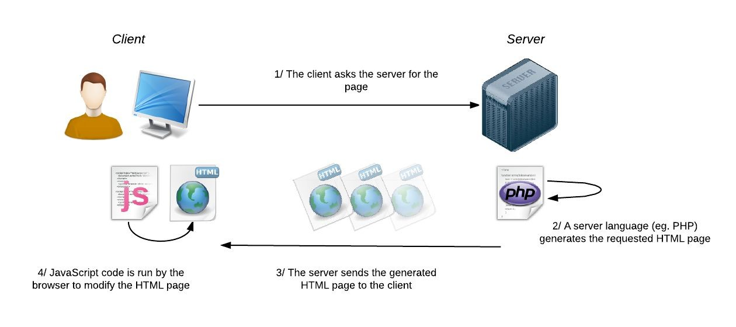
Working with Node.js
Before Node.js:
Before Node.js, JavaScript was always used on the client’s side. The browser would run the JavaScript code and perform the actions on the browser.
As shown in the figure, the server side was handled by languages such as PHP and Python.
19

Slide 12
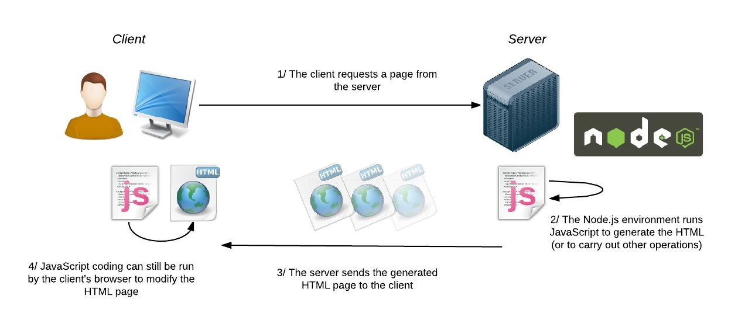
Working with Node.js
With Node.js:
Node.js has all the power of JavaScript and offers us a whole new way of developing dynamic websites.
We can still use JavaScript on the client-side to manipulate the HTML page.
However, Node.js offers a server-side environment, which allows us to use JavaScript language to generate web pages. Basically, it replaces server languages such as PHP, Java EE and Python.
18

Slide 13
Working with Node.js
What is Node.js?
Node.js is defined on the official Node.js website as:
Node.js is a JavaScript runtime built on Chrome’s V8 JavaScript engine.
Node.js uses an event-driven, non-blocking I/O model that makes it lightweight and efficient.
I/O refers to input/output. It can be anything ranging from reading/writing local files to making an HTTP request to an API.
I/O takes time and hence blocks other functions.
Consider a scenario, where we request a backend database for the details of user1 and user2 and then print them on the screen/console. The response to this request takes time, but both of the user data requests can be carried out independently and at the same time.
13

Slide 14
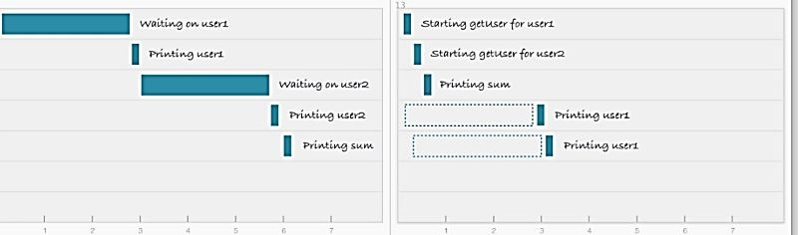
Working with Node.js
Blocking I/O
In the blocking method, user2's data request is not initiated until user1's data is printed to the screen.
If this was a web server, we would have to start a new thread for every new user.
Non-blocking I/O
On the other hand, using a non-blocking request, you can initiate a data request for user2 without waiting for the response to the request for user1. You can initiate both requests in parallel.
This non-blocking I/O eliminates the need for multi-threading, since the server can handle multiple requests at the same time.
Blocking I/O (left) vs. Non-Blocking I/O (right)
14

Slide 15
Working with Node.js
Non-blocking I/O – The restaurant analogy:
Consider going to a restaurant.
As soon as you place the order, it is sent off to the kitchen to be fulfilled while the cashier takes your payment.
Once you have paid, you must step aside to allow the next customer to be serviced by the cashier.
When your order is complete, you will be called back.
In Node.js:
The node server receives a request for/about HTML.
While node waits for the file system to get the file, the server thread services the next request.
When the file is ready, a callback function inserted in the server thread calls back the node to complete the first request.

Slide 16




Working with Node.js
Node.js Architecture
Node.js comprises of the following:
libuv – A high performance, cross-platform evented I/O library.
V8 – Google’s JavaScript engine (also used in Chrome). Each release of node includes the updated version of V8 thereby, benefitting from Google’s continuous innovation of the JavaScript engine.
The custom C++ and JS code developed for the Node platform.
libuv
+
V8
+
JS,C++
=
Node.js

Slide 17
Working with Node.js
Features of Node.js
Asynchronous and Event Driven − All APIs of Node.js library are asynchronous, i.e., non-blocking. It essentially means a Node.js based server never waits for an API to return data. The server moves to the next API after calling it and a notification mechanism of Events of Node.js helps the server to get a response from the previous API call.
Very Fast − Being built on Google Chrome's V8 JavaScript Engine, Node.js library is very fast in code execution.
Single Threaded but Highly Scalable − Node.js uses a single threaded model with event looping. Event mechanism helps the server to respond in a non-blocking way and makes the server highly scalable as opposed to traditional servers which create limited threads to handle requests. Node.js uses a single threaded program and the same program can provide service to a much larger number of requests than traditional servers like Apache HTTP Server.
No Buffering − Node.js applications never buffer any data. These applications simply output the data in chunks.
License − Node.js is released under the MIT license
17

Slide 18
Working with Node.js
Setting up Node.js Environment
17

Slide 19
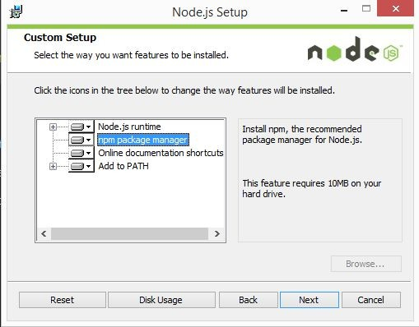
Working with Node.js
Setting up Node.js Environment:
Installing Node and NPM is pretty straightforward using the installer package available from the Node.js website.
Download the Windows installer from the Nodes.js website.
Run the installer (the .msi file you downloaded in the previous step).
Follow the prompts in the installer (Accept the license agreement, click the NEXT button a couple of times and accept the default installation settings).
17

Slide 20
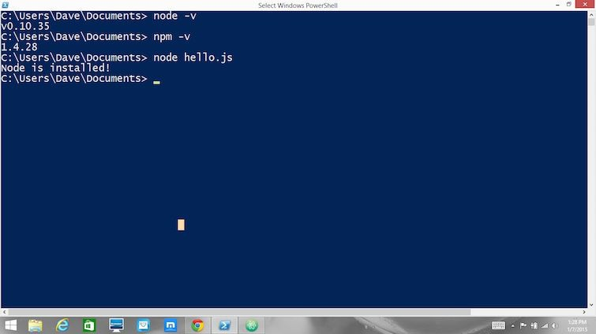
Working with Node.js
Testing Node.js Environment
Make sure you have Node and NPM installed by running simple commands to see what version of each is installed and to run a simple test program:
Test Node. To see if Node is installed, open the Windows Command Prompt, PowerShell or a similar command line tool, and type node -v. This should print a version number something like this:
v0.10.35
Test NPM. To see if NPM is installed, type NPM -v in Terminal. This should print NPM’s version number so you’ll see something like this 1.4.28
Create a test file and run it. A simple way to test that node.js works is to create a JavaScript file: name it hello.js, and just add the line :
console.log('Node is installed!');
To run the code simply open your command line program, navigate to the folder where you saved the file and type
node hello.js
This will start Node and run the code in the hello.js file. You should see the output
Node is installed!
17

Slide 21
Working with Node.js
Creating Node.js Application:
Before creating an actual "Hello, World!" application using Node.js, let us see the components of a Node.js application. A Node.js application consists of the following three important components −
Import required modules − We use the required directive to load the http module and store the returned HTTP instance into an http variable as follows −
var http = require("http");
Create server − A server which will listen to client's requests similar to Apache HTTP Server. In Node, the server and the application are the same. We use the created http instance and call http.createServer() method to create a server instance and then we bind it at port 8081 using the listen method associated with the server instance.
17

Slide 22
Working with Node.js
(Continued) Creating Node.js Application:
Pass it as a function with parameters request and response and program it to always return "Hello World".
http.createServer(function (request, response) {
// Send the HTTP header
// HTTP Status: 200 : OK
// Content Type: text/plain
response.writeHead(200, {'Content-Type': 'text/plain'});
// Send the response body as "Hello World" response.end('Hello World\n');
}).listen(8081);
// Console will print the message
console.log('Server running at http://127.0.0.1:8081/')
22

Slide 23
Working with Node.js
Creating Node.js Application:
Read request and return response
The server created in the earlier step will read the HTTP request made by the client which can be a browser or a console and returns the response.
Whenever a request happens, the function (req, res) callback is fired and “Hello World” is written out as the response.
This event model is akin to listening to an onclick event in the browser. A click could happen at any point, so you set up a function to perform some logic to handle that.
Here, Node provides a function that responds whenever a request happens.
17

Slide 24
Working with Node.js
REPL Terminal
NPM- Node Package Manager
17

Slide 25
Working with Node.js
Node.js – REPL Terminal
REPL stands for Read Eval Print Loop and it represents a computer environment like a Windows console or Unix/Linux shell where a command is entered and the system responds with an output in an interactive mode.
Node.js or Node comes bundled with a REPL environment. It performs the following tasks −
Read − Reads user's input, parses the input into JavaScript data-structure, and stores in memory.
Eval − Takes and evaluates the data structure.
Print − Prints the result.
Loop − Loops the above command until the user presses ctrl-c twice.
The REPL feature of Node is very useful in experimenting with Node.js codes and to debug JavaScript codes.
17

Slide 26
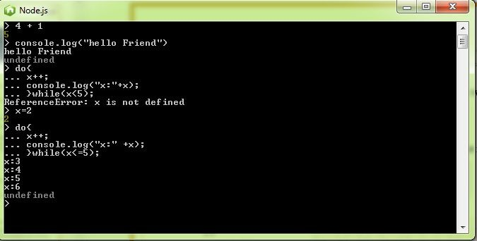
Working with Node.js
Node.js – REPL Terminal
REPL can be started by simply running node on shell/console without any arguments as follows.
$ node
The REPL command prompt > appears where we can enter the node commands. Example:
$node
> 60/4 15
> x = 10 10
> console.log(“Hello World!”) Hello World!
undefined
Stopping REPL:
Use ctrl-c twice to come out of Node.js REPL.
$ node
> (^C again to quit)
>
17

Slide 27
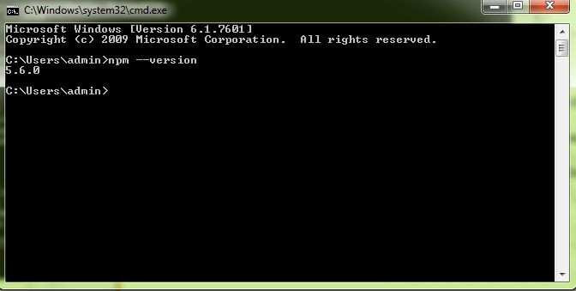
Working with Node.js
Node.js – NPM
Node Package Manager (NPM) provides two main functionalities −
Online repositories for node.js packages/modules which are searchable on search.nodejs.org
Command line utility to install Node.js packages, do version management and dependency management of Node.js packages.
NPM comes bundled with Node.js installable after v0.6.3 version. You can check the version using the,
$ NPM –version
17

Slide 28
Working with Node.js
Modules in Node.js:
Modules in Node js are a way of encapsulating code in a separate logical unit. There are many readymade modules available in the market which can be used within Node js.
You can think of modules as similar to JavaScript libraries. A set of functions you want to include in your application.
Below are some of the popular modules which are used in a Node js application
Express framework – Express is a minimal and flexible Node js web application framework that provides a robust set of features for the web and Mobile applications.
Socket.io - Socket.IO enables real-time bidirectional event-based communication. This module is good for creation of chatting based applications.
Jade - Jade is a high-performance template engine and implemented with JavaScript for node and browsers.
MongoDB - The MongoDB Node.js driver is the officially supported node.js driver for MongoDB.
Restify - Restify is a lightweight framework, similar to express for building REST APIs.
Bluebird - Bluebird is a fully featured promise library with focus on innovative features and performance.
17

Slide 29
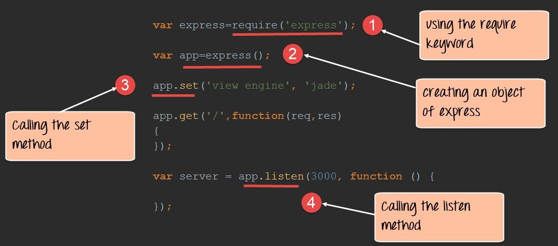
Working with Node.js
Importing the module using ‘require’ keyword:
Let's look at an example how we can use the "require" keyword.
17

Slide 30
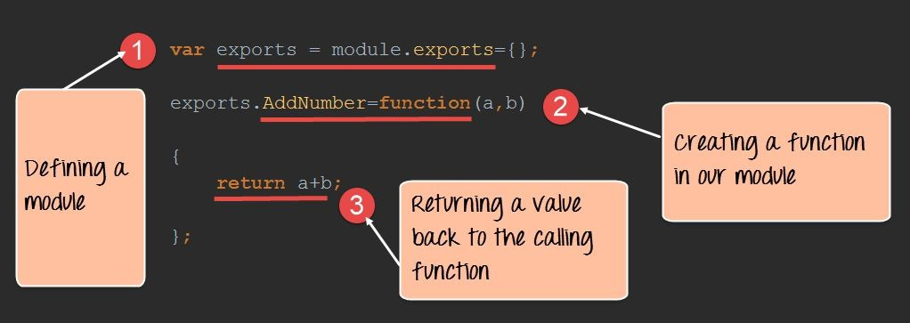
Working with Node.js
Creating NPM Modules
Node.js has the ability to create custom modules and allows you to include those custom modules in your Node.js application.
Let's look at a simple example of how we can create our own module and include that module in our main application file. Our module will just do a simple task of adding 2 numbers.
It is a 2-step process: Create the module and Create an application which calls the module.
17

Slide 31
Working with Node.js
(Continued) Creating NPM Module:
var exports=module.exports={}; exports.AddNumber=function(a,b)
{
return a+b;
};
The "exports" keyword is used to ensure that the functionality defined in this file can actually be accessed by other files.
We are then defining a function called 'AddNumber'. This function is defined to take 2 parameters, a and b. The function is added to the module "exports" to make the function as a public function that can be accessed by other application modules.
We are finally making our function return the added value of the parameters.
17

Slide 32
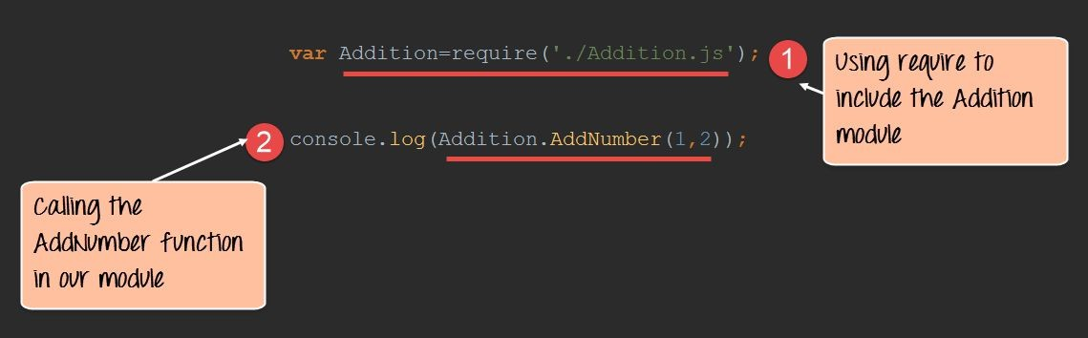
Working with Node.js
(Continued) Creating NPM Module:
In the next step, we will actually see how to create the application which will call our custom module.
Create a file called "app.js," which is your main application file and add the below code.
17

Slide 33
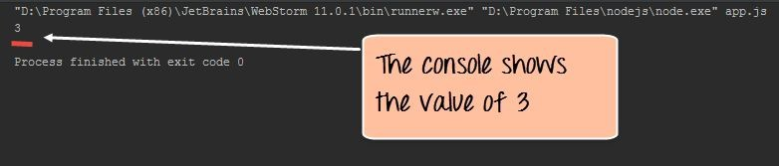
Working with Node.js
(Continued) Creating NPM Module:
var Addition=require('./Addition.js'); console.log(Addition.AddNumber(1,2));
We are using the "require" keyword to include the functionality in the Addition.js file.
Since, the functions in the Addition.js file are now accessible, we can now make a call to the AddNumber function. In the function, we are passing 2 numbers as parameters. We are then displaying the value in the console.
Output:
When you run the app.js file, you will get an output of value 3 in the console log.
17

Slide 34
Working with Node.js
Publishing NPM (Node Package Manager) Modules
We can publish our modules on the Github repository – www.github.com , this way all modules are published in a central location. The install command of NPM can be used to install the published modules.
The following steps needs to be followed to publish an NPM module:
Create your repository on GitHub (an online code repository management tool). It can be used for hosting your code repositories.
You need to tell your local NPM installation on who you are. Which means that we need to tell NPM who is the author of this module, what is the email id and any company URL, which is available which needs to be associated with this id. All of these details will be added to the NPM module when it is published.
The below commands sets the name, email and URL of the author of the NPM module.
npm | set | init.author.name “author name"
npm | set | init.author.email “author mail"
npm | set | init.author.url URL
4. The next step is to login into NPM using the credentials provided in the last step. To login, you need to use the below command:
npm login
17

Slide 35
Working with Node.js
Publishing NPM (Node Package Manager) Modules
Initialize your package – The next step is to initialize the package to create the package.json file. This can be done by issuing the below command.
npm init
Publish to GitHub – The next step is to publish your source files to GitHub. This can be done by running the below commands.
git add.
git commit -m "Initial release" git tag v0.0.1
git push origin master --tags
Publish your module – The final bit is to publish your module into the npm registry. This is done via the below command.
npm publish
17

Slide 36
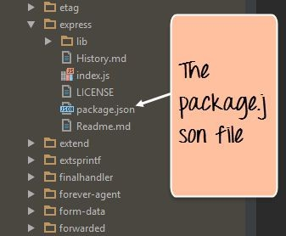
Working with Node.js
What is the package.json file
The "package.json" file is used to hold the metadata about a particular project. This information provides the Node package Manager the necessary information to understand how the project should be handled along with its dependencies.
The package.json files contains information such as the project description, the version of the project in a particular distribution, license information, and configuration data.
The package.json file is normally located at the root directory of a Node.js project.
The below snapshot shows the file contents of the express module when it is included in your Node.js project. From the snapshot, you can see the package.json file in the express folder. If you open the package.json file you will see a lot of information in the file.
17

Slide 37
Working with Node.js
Callbacks, Event Loops, Event Emitters, Timers and Listeners
17

Slide 38
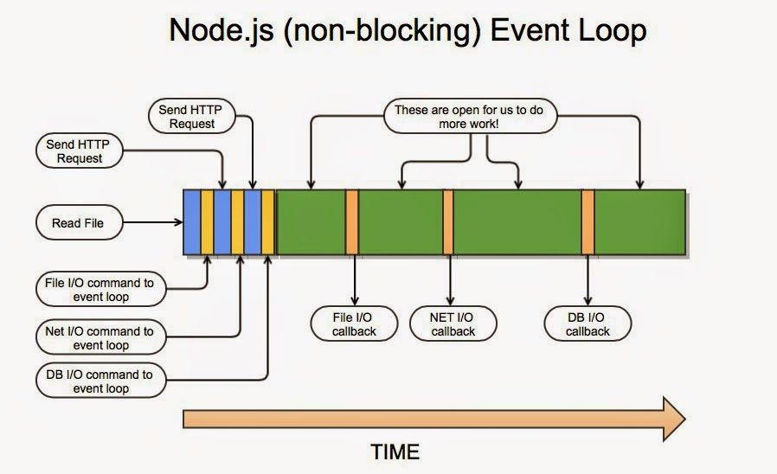
Working with Node.js
What is Callback?
Callback is an asynchronous equivalent for a function. A callback function is called at the completion of a given task. Node makes heavy use of callbacks. All the APIs of Node are written in such a way that they support callbacks.
Example: A function to read a file may start reading file and return the control to the execution environment immediately so that the next instruction can be executed.
Once file I/O is complete, it will call the callback function while passing the callback function, the content of the file as a parameter. So there is no blocking or wait for File I/O.
This makes Node.js highly scalable, as it can process a high number of requests without waiting for any function to return results.
17

Slide 39
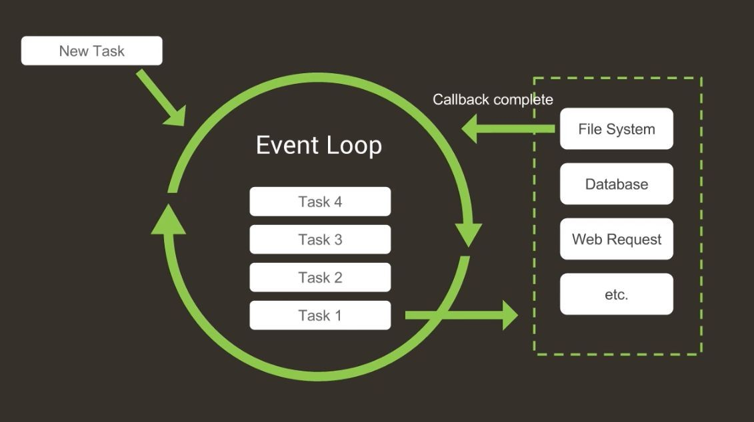
Working with Node.js
Node.js is event driven – it uses an event loop:
Another important thing about Node.js is that it's event driven, and it has a concept called event loop.
Node.js works in a single thread. The event loop is what allows Node.js to perform non-blocking I/O operations — despite the fact that JavaScript is single-threaded — by offloading operations to the system kernel whenever possible.
Consider the given figure, here task1 is to store a file, that is going to be done by the file system. The task2 could be to store information in the database or retrieve information from a database.
The node sends these requests to the respective systems to be completed and instead of waiting for the results to arrive moves on to task3 which is a web server request.
When the file system has completed the task, a callback function returns the results. The results arrived will be stacked on the top of the loop, and whatever printing needs to be done is carried out.
39

Slide 40
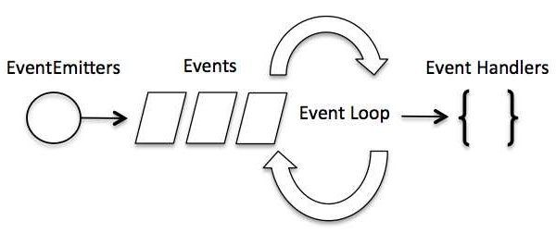
Working with Node.js
Event-Driven Programming
Node.js uses events heavily and it is also one of the reasons why Node.js is pretty fast compared to other similar technologies. As soon as Node starts its server, it simply initiates its variables, declares functions and then simply waits for the event to occur.
In an event-driven application, there is generally a main loop that listens for events, and then triggers a callback function when one of those events is detected.
Although events look quite similar to callbacks, the difference lies in the fact that callback functions are called when an asynchronous function returns its result, whereas event handling works on the observer pattern. The functions that
listen to events act as Observers.
40

Slide 41
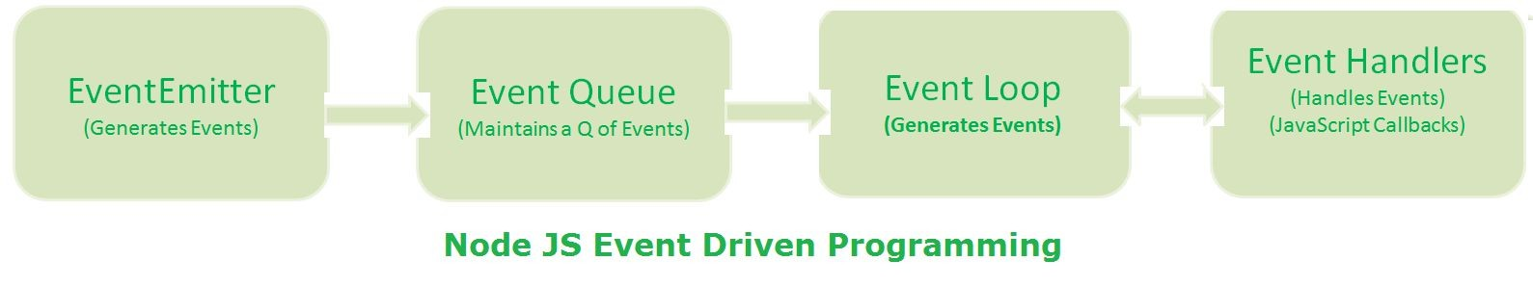
Working with Node.js
Event-Driven Programming
When Node js application starts or ends an operation, EventEmitter class generates events and places them into Event Queue.
Event Queue maintains a Queue of Events.
Event Loop continuously waits for new events in Event Queue. When it finds events in Event Queue, it pulls them and try to process them. If they require IO Blocking operations or long waiting tasks, then assigns respective Event Handlers to handle them.
Event Handlers are JavaScript Asynchronous Callback Functions. They are responsible to handle events and return results to Event Loop.
Event Loop will prepare results and send them back to the Client.

Slide 42
Working with Node.js
Event-Driven Programming
Whenever an event gets fired, its listener function starts executing. Node.js has multiple in-built events available through events module and EventEmitter class which are used to bind events and event-listeners as follows:
// Import events module
var events = require('events');
// Create an eventEmitter object
var eventEmitter = new events.EventEmitter();
Following is the syntax to bind an event handler with an event −
// Bind event and event handler as follows eventEmitter.on('eventName', eventHandler);
We can fire an event programmatically as follows −
// Fire an event eventEmitter.emit('eventName');

Slide 43
Working with Node.js
Node.js Event Emitter
Node.js core API is based on asynchronous event-driven architecture in which certain kind of objects called emitters periodically emit events that cause listener objects to be called.
Many objects in a Node emit events, for example, a net.Server emits an event each time a peer connects to it, an fs.readStream emits an event when the file is opened. All objects which emit events are the instances of events.EventEmitter..
EventEmitter class lies in the events module. It is accessible via the following code −
// Import events module
var events = require('events');
// Create an eventEmitter object
var eventEmitter = new events.EventEmitter();
When an EventEmitter instance faces any error, it emits an 'error' event. When a new listener is added, 'newListener' event is fired and when a listener is removed, 'removeListener' event is fired.
EventEmitter provides multiple properties like on and emit. On property is used to bind a function with the event and emit is used to fire an event.
43

Slide 44
Working with Node.js
Timers
A timer specifies the threshold after which a provided callback may be executed rather than the exact time a person wants it to be executed.
Timers callbacks will run as early as they can be scheduled after the specified amount of time has passed; however, Operating System scheduling or the running of other callbacks may delay them.
Example: say you schedule a timeout to execute after a 100 ms threshold, then your script starts asynchronously reading a file which takes 95 ms.
When the event loop enters the poll phase, it has an empty queue (fs.readFile() has not completed), so it will wait for the number of ms remaining until the soonest timer's threshold is reached. While it is waiting 95 ms pass, fs.readFile() finishes reading the file and its callback which takes 10 ms to complete is added to the poll queue and executed.
When the callback finishes, there are no more callbacks in the queue, so the event loop will see that the threshold of the soonest timer has been reached then wrap back to the timers phase to execute the timer's callback.
In this example, you will see that the total delay between the timer being scheduled and its callback being executed will be 105 ms.
44

Slide 45
Working with Node.js
Buffers and Streams
17

Slide 46
Working with Node.js
Why Buffers?
Pure JavaScript is Unicode friendly, but it is not so for binary data. While dealing with TCP streams or the file system, it is necessary to handle octet streams.
The Buffer class was introduced as part of the Node.js API to enable interaction with octet streams in TCP streams, file system operations, and other contexts.
Instances of the Buffer class are similar to arrays of integers but correspond to fixed-sized, raw memory allocations outside the V8 heap. The size of the Buffer is established when it is created and cannot be changed.
Buffer class is a global class that can be accessed in an application without importing the buffer module.
What are Buffers?
Buffers are instances of the Buffer class in node, which is designed to handle raw binary data. Each buffer corresponds to some raw memory allocated outside V8.
Buffers act somewhat like arrays of integers, but non-resizable and have a whole bunch of methods specifically for binary data.
In addition, the "integers" in a buffer, each represent a byte and so are limited to values from 0 to 255 (2^8 - 1), inclusive.
46

Slide 47
Working with Node.js
Creating a Buffer:
Method 1: Following is the syntax to create an uninitiated Buffer of 10 octets −
var buf = new Buffer(10);
Method 2: Following is the syntax to create a Buffer from a given array −
var buf = new Buffer([10, 20, 30, 40, 50]);
Method 3: Following is the syntax to create a Buffer from a given string and optionally encoding type −
var buf = new Buffer("Simply Easy Learning", "utf-8");
Though "utf8" is the default encoding, you can use any of the following encodings "ascii", "utf8", "utf16le", "ucs2", "base64" or "hex".
47

Slide 48
Working with Node.js
Writing to Buffers
buf.write(string[, offset][, length][, encoding])
Parameters:
Here is the description of the parameters used:
String − This is the string data to be written to buffer.
Offset − This is the index of the buffer to start writing at. Default value is 0.
Length − This is the number of bytes to write. Defaults to buffer.length.
Encoding − Encoding to use. 'utf8' is the default encoding.
Return Value:
This method returns the number of octets written. If there is not enough space in the buffer to fit the entire string, it will write a part of the string.
Example:
buf = new Buffer(256);
len = buf.write("Simply Easy Learning"); console.log("Octets written : "+ len);
Output: Octets written : 20
48

Slide 49
Working with Node.js
Reading from Buffers
buf.toString([encoding][, start][, end])
Parameters:
Here is the description of the parameters used −
Encoding − Encoding to use. 'utf8' is the default encoding.
Start − Beginning index to start reading, defaults to 0.
End − End index to end reading, defaults is complete buffer.
Return Value:
This method decodes and returns a string from buffer data encoded using the specified character set encoding.
Example:
buf = new Buffer(26);
for (var i = 0 ; i < 26 ; i++) { buf[i] = i + 97;}
console.log( buf.toString('ascii')); console.log( buf.toString('ascii',0,5)); console.log( buf.toString('utf8',0,5));
// outputs: abcdefghijklmnopqrstuvwxyz
// outputs: abcde
// outputs: abcde
console.log( buf.toString(undefined,0,5)); // encoding defaults to 'utf8', outputs abcde
Output: abcdefghijklmnopqrstuvwxyz abcde
abcde abcde
49

Slide 50
Working with Node.js
Buffer Module Methods
Sl.No. | Method and Description
1 | Buffer.isEncoding(encoding) Returns true if the encoding is a valid encoding argument, false otherwise.
2 | Buffer.isBuffer(obj) Tests if obj is a Buffer.
3 | Buffer.byteLength(string[, encoding]) Gives the actual byte length of a string. encoding defaults to 'utf8'. It is not the same as String.prototype.length, since String.prototype.length returns the number of characters in a string.
4 | Buffer.concat(list[, totalLength]) Returns a buffer which is the result of concatenating all the buffers in the list together.
5 | Buffer.compare(buf1, buf2) The same as buf1.compare(buf2). Useful for sorting an array of buffers.

Slide 51
Working with Node.js
Streams
Streams are objects that let you read data from a source or write data to a destination in continuous fashion.
Stream is an EventEmitter instance and throws several events at different instance of times. Some of the commonly used events are −
data − This event is fired when there is data is available to read.
end − This event is fired when there is no more data to read.
error − This event is fired when there is any error receiving or writing data.
finish − This event is fired when all the data has been flushed to underlying system.
There are four types of streams:
Readable − Stream which is used for read operation.
Writable − Stream which is used for write operation.
Duplex − Stream which can be used for both read and write operation.
Transform − A type of duplex stream where the output is computed based on input.

Slide 52
Working with Node.js
Reading from a Stream
Create a text file named input.txt having the following content −
Hello World.
Its time to switch to Node.js!!!
Create a js file named main.js with the following code −
var fs = require("fs"); var data = '';
// Create a readable stream
var readerStream = fs.createReadStream('input.txt');
// Set the encoding to be utf8. readerStream.setEncoding('UTF8');
// Handle stream events --> data, end, and error readerStream.on('data', function(chunk)

Slide 53
Working with Node.js
Reading from a Stream
Now run the main.js to see the result −
$ node main.js
Output
Program Ended Hello World.
Its time to switch to Node.js!!!

Slide 54
Working with Node.js
Writing to a Stream
Create a js file named main.js with the following code −
var fs = require("fs");
var data = 'Simply Easy Learning';
// Create a writable stream
var writerStream = fs.createWriteStream('output.txt');
// Write the data to stream with encoding to be utf8 writerStream.write(data,'UTF8');
// Mark the end of file writerStream.end();
// Handle stream events --> finish, and error writerStream.on('finish', function() {
console.log("Write completed.");
});
54
writerStream.on('error', function(err){

Slide 55
Working with Node.js
Writing to a Stream
Now run the main.js to see the result −
$ node main.js
Output
Program Ended Write completed.
Now open output.txt created in your current directory; it should contain the following − Simply Easy Learning

Slide 56
Working with Node.js
Piping the Streams
Piping is a mechanism where we provide the output of one stream as the input to another stream.
It is normally used to get data from one stream and to pass the output of that stream to another stream.
There is no limit on piping operations.
Here is an example of piping for reading from one file and writing it to another file.
Create a js file named main.js with the following code −
var fs = require("fs");
// Create a readable stream
var readerStream = fs.createReadStream('input.txt');

Slide 57
Working with Node.js
Piping the Streams
Now run the main.js to see the result −
$ node main.js
Output
Program Ended
Now open output.txt created in your current directory; it should contain the same information you stored in input.txt.

Slide 58
Working with Node.js
Chaining the Streams
Chaining is a mechanism to connect the output of one stream to another stream and create a chain of multiple stream operations. It is normally used with piping operations.
Here is an example which uses piping and chaining to first compress a file and then decompress it.
Create a js file named main.js with the following code −
var fs = require("fs");
var zlib = require('zlib');
// Compress the file input.txt to input.txt.gz fs.createReadStream('input.txt')
pipe(zlib.createGzip())

Slide 59
Working with Node.js
Chaining the Streams
You will find that input.txt has been compressed and it created a file input.txt.gz in the current directory.
Let us decompress the same file -
var fs = require("fs");
var zlib = require('zlib');
// Decompress the file input.txt.gz to input.txt fs.createReadStream('input.txt.gz')
.pipe(zlib.createGunzip())
.pipe(fs.createWriteStream('input.txt'));
59

Slide 60
Working with Node.js
File System and Global Objects
17

Slide 61
Working with Node.js
File System in Node.js
Node.js includes fs module to access physical file system. The fs module is responsible for all the asynchronous or synchronous file I/O operations.
The Node File System (fs) module can be imported using the following syntax −
var fs = require("fs")
Let us see some of the common I/O operation examples using fs module.
Reading a File
Use fs.readFile() method to read the physical file asynchronously.
fs.readFile(fileName [,options], callback)
filename: Full path and name of the file as a string.
options: The options parameter can be an object or string which can include encoding and flag. The default encoding is utf8 and default flag is "r".
callback: A function with two parameters err and fd. This will get called when readFile operation completes.

Slide 62
Working with Node.js
Example – Reading a File Asynchronously
The following example reads a file asynchronously.
var fs = require('fs'); fs.readFile('TestFile.txt', function (err, data) {
if (err) throw err;
console.log(data);
});
TextFile.txt
This is test file to test fs module of Node.js Asynchronously.
Output:
C:\> node server.js
This is test file to test fs module of Node.js Asynchronously.

Slide 63
Working with Node.js
Example – Reading a File Synchronously
var fs = require('fs');
var data = fs.readFileSync('dummyfile.txt', 'utf8'); console.log(data);
TextFile.txt
This is test file to test fs module of Node.js synchronously
Output:
C:\> node server.js
This is test file to test fs module of Node.js synchronously.

Slide 64
Working with Node.js
Writing File
Use fs.writeFile() method to write data to a file. If file already exists then it overwrites the existing content otherwise it creates a new file and writes data into it.
fs.writeFile(filename, data[, options], callback)
filename: Full path and name of the file as a string.
Data: The content to be written in a file.
Options: The options parameter can be an object or string which can include encoding, mode and flag. The default encoding is utf8 and default flag is "r".
Callback: A function with two parameters err and fd. This will get called when write operation
completes.
64

Slide 65
Working with Node.js
Example: Creating and Writing File
The following example creates a new file called test.txt and writes "Hello World" into it asynchronously.
var fs = require('fs');
fs.writeFile('test.txt', 'Hello World!', function (err) { if (err)
console.log(err);
else
console.log('Write operation complete.');
});
In the same way, use fs.appendFile() method to append the content to an existing file.
var fs = require('fs');
fs.appendFile('test.txt', 'Hello World!', function (err) {
if (err) console.log(err);
else
console.log('Append operation complete.');
});
65

Slide 66
Working with Node.js
Open File
You can open a file for reading or writing using fs.open() method.
fs.open(path, flags[, mode], callback)
path: Full path with name of the file as a string.
Flag: The flag to perform operation.
Mode: The mode for read, write or readwrite. Defaults to 0666 readwrite.
Callback: A function with two parameters err and fd. This will get called when file open operation completes.
The flag options that can be used to open a file are given in the next slide.

Slide 67
Working with Node.js
Flags
Flag | Description
r | Open file for reading. An exception occurs if the file does not exist.
r+ | Open file for reading and writing. An exception occurs if the file does not exist.
rs | Open file for reading in synchronous mode.
rs+ | Open file for reading and writing, telling the OS to open it synchronously. See notes for 'rs' about using this with caution.
w | Open file for writing. The file is created (if it does not exist) or truncated (if it exists).
wx | Like 'w' but fails if path exists.
w+ | Open file for reading and writing. The file is created (if it does not exist) or truncated (if it exists).
wx+ | Like 'w+' but fails if path exists.
a | Open file for appending. The file is created if it does not exist.
ax | Like 'a' but fails if path exists.
a+ | Open file for reading and appending. The file is created if it does not exist.
ax+ | Like 'a+' but fails if path exists.

Slide 68
Working with Node.js
Example: File open and read
The following example opens an existing file and reads its content.
var fs = require('fs');
fs.open('TestFile.txt', 'r', function (err, fd) {
if (err) {
return console.error(err);
}
var buffr = new Buffer(1024); fs.read(fd, buffr, 0, buffr.length, 0, function (err, bytes) {
if (err) throw err;
// Print only read bytes to avoid junk. if (bytes > 0) {
console.log(buffr.slice(0, bytes).toString());
}
// Close the opened file. fs.close(fd, function (err) {
68

Slide 69
Working with Node.js
Delete File
Use fs.unlink() method to delete an existing file.
fs.unlink(path, callback);
The following example deletes an existing file.
var fs = require('fs');
fs.unlink('test.txt', function () { console.log('write operation complete.');
});
Closing a File
Following is the syntax to close an opened file −
fs.close(fd, callback)
fd − This is the file descriptor returned by file fs.open() method.
callback − This is the callback function No arguments other than a possible exception are given to the completion callback.
69

Slide 70
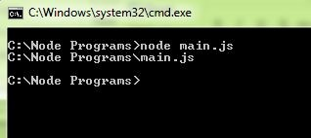
Working with Node.js
Node.js Global Objects
Node.js global objects are global in nature and they are available in all modules.
We do not need to include these objects in our application, rather we can use them directly.
The following slides describe the global objects in Node.js.
filename (two underscores at the beginning)
The filename represents the filename of the code being executed.
This is the resolved absolute path of this code file.
For a main program, this is not necessarily the same filename used in the command line.
The value inside a module is the path to that module file.
Example:
Create a js file named main.js with the following code −
// Let's try to print the value of filename
console.log( filename );
Based on the location of your program, it will print the main file name

Slide 71
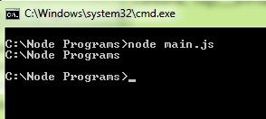
Working with Node.js
Node.js Global Objects
2. dirname (two underscores at the beginning)
The dirname represents the name of the directory that the currently executing script resides in.
Example:
Create a js file named main.js with the following code −
// Let's try to print the value of dirname
console.log( dirname );
Based on the location of your program, it will print the directory name.

Slide 72
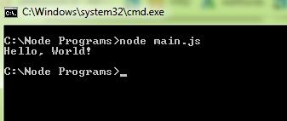
Working with Node.js
Node.js Global Objects
setTimeout(cb, ms)
The setTimeout(cb, ms) global function is used to run callback cb after at least ms milliseconds. The actual delay depends on external factors like OS timer granularity and system load. A timer cannot span more than
24.8 days.
This function returns an opaque value that represents the timer which can be used to clear the timer.
Example:
Create a js file named main.js with the following code −
function printHello() console.log( "Hello, World!");
}
// Now call above function after 2 seconds setTimeout(printHello, 2000);
Output

Slide 73
Working with Node.js
Node.js Global Objects
4. clearTimeout(t)
The clearTimeout(t) global function is used to stop a timer that was previously created with setTimeout(). Here t is the timer returned by the setTimeout() function.
Example:
Create a js file named main.js with the following code −
function printHello(){ console.log( "Hello, World!");
}
// Now call above function after 2 seconds var t = setTimeout(printHello, 2000);
// Now clear the timer clearTimeout(t);
Verify the output where you will not find anything printed.

Slide 74
Working with Node.js
Node.js Global Objects
setInterval(cb, ms)
The setInterval(cb, ms) global function is used to run callback cb repeatedly after at least ms milliseconds. The actual delay depends on external factors like OS timer granularity and system load. A timer cannot span more than 24.8 days.
This function returns an opaque value that represents the timer which can be used to clear the timer using the function clearInterval(t).s
Example:
Create a js file named main.js with the following code −
function printHello(){ console.log( "Hello, World!");
}
// Now call above function after 2 seconds setInterval(printHello, 2000);
The above program will execute printHello() after every 2 second.

Slide 75
Working with Node.js
Utility Modules, Web Module
17

Slide 76
Working with Node.js
Node.js - Utility Modules
There are several utility modules available in Node.js module library. These modules are very common and are frequently used while developing any Node based application.
OS Module - Provides basic operating-system related utility functions.
Path Module - Provides utilities for handling and transforming file paths.
Net Module - Provides both servers and clients as streams. It acts as a network wrapper.
DNS Module - Provides functions to do actual DNS lookup as well as to use underlying operating system name resolution functionalities.
Domain Module - Provides ways to handle multiple different I/O operations as a single group.

Slide 77
Working with Node.js
Node.js - Web Module
What is a Web Server?
A Web Server is a software application which handles HTTP requests sent by the HTTP client, like web browsers, and returns web pages in response to the clients. Web servers usually deliver html documents along with images, style sheets, and scripts.
Most of the web servers support server-side scripts, using scripting languages or redirecting the task to an application server which retrieves data from a database and performs complex logic and then sends a result to the HTTP client through the Web server.
Node.js - Creating a Web Server using Node
Node.js provides an http module which can be used to create an HTTP client of a server.

Slide 78
Working with Node.js
Following is the bare minimum structure of the HTTP server which listens at 8081 port.
Server.js
var http = require('http'); var fs = require('fs');
var url = require('url');
// Create a server
http.createServer( function (request, response) {
// Parse the request containing file name
var pathname = url.parse(request.url).pathname;
// Print the name of the file for which request is made. console.log("Request for " + pathname + " received.");

Slide 79
Working with Node.js
(Continued) Following is the bare minimum structure of the HTTP server which listens at 8081 port.
// Read the requested file content from file system fs.readFile(pathname.substr(1), function (err, data) {
if (err) { console.log(err);
// HTTP Status: 404 : NOT FOUND
// Content Type: text/plain
response.writeHead(404, {'Content-Type': 'text/html'});
}else {
//Page found
// HTTP Status: 200 : OK
// Content Type: text/plain
response.writeHead(200, {'Content-Type': 'text/html'});
// Write the content of the file to response body response.write(data.toString());
}
// Send the response body response.end();
});
79

Slide 80
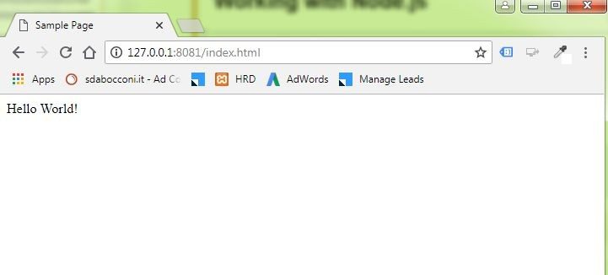
Working with Node.js
Node.js - Web Module
File: index.htm
<html>
<head>
<title>Sample Page</title>
</head>
<body>
Hello World!
</body>
</html>
Run the server.js to see the result −
$ node server.js
Output.
Server running at http://127.0.0.1:8081/
80

Slide 81
Working with Node.js
Node.js - Web Module
Creating Web client using Node
Client.js
var http = require('http');
// Options to be used by request var options = {
host: 'localhost', port: '8081', path: '/index.htm'
};
// Callback function is used to deal with response var callback = function(response){
// Continuously update stream with data var body = '';
response.on('data', function(data) { body += data;
});
81

Slide 82
Working with Node.js
Node.js - Web Module
Now run the client.js from a different command terminal other than server.js to see the result −
$ node client.js
Output:
<html>
<head>
<title>Sample Page</title>
</head>
<body>
Hello World!
</body>
</html>
Output at Server end:
Server running at http://127.0.0.1:8081/ Request for /index.htm received.
82

Slide 83
Working with Node.js
Express Framework
17

Slide 84
Working with Node.js
What is Express.js?
Express.js is a Node js web application server framework, which is specifically designed for building single-page, multi-page, and hybrid web applications.
It has become the standard server framework for node.js. Express is the backend part of something known as the MEAN stack.
The MEAN is a free and open-source JavaScript software stack for building dynamic websites and web applications which has the following components:
MongoDB - The standard NoSQL database.
Express.js - The default web applications framework.
Angular.js - The JavaScript MVC framework used for web applications.
Node.js - Framework used for scalable server-side and networking applications.
The Express.js framework makes it very easy to develop an application which can be used to handle multiple types of requests like the GET, PUT, and POST and DELETE requests.
84

Slide 85
Working with Node.js
Installing Express
Express gets installed via the Node Package Manager. This can be done by executing the following line in the command line.
NPM install express
Let us create a simple ‘Hello World’ application using express framework.
The application is going to create a simple server module which will listen on port no 3000. In our example, if a request is made through the browser on this port no, then server application will send a 'Hello' World' response to the client.

Slide 86
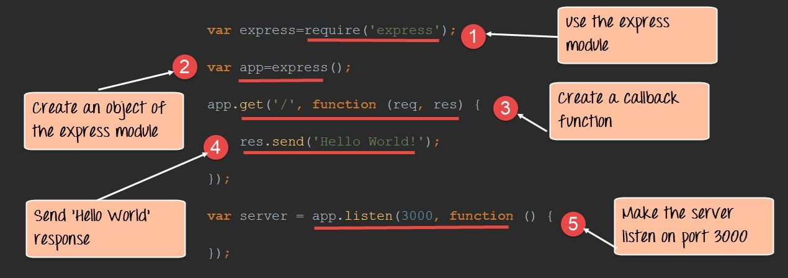
Working with Node.js
‘Hello World’ Application using Express Framework:
var express=require('express'); var app=express(); app.get('/',function(req,res)
{
res.send('Hello World!');
});
var server=app.listen(3000,function() {});

Slide 87
Working with Node.js
‘Hello World’ Application using Express Framework:
In the first line of code, we are using the required function to include the "express module."
Before we can start using the express module, we need to make an object of the express module.
Here, we are creating a callback function. This function will be called whenever anybody browses to the root of our web application which is http://localhost:3000 . The callback function will be used to send the string 'Hello World' to the web page.
In the callback function, we are sending the string "Hello World" back to the client. The 'res' parameter is used to send content back to the web page. This 'res' parameter is something that is provided by the 'request' module to enable one to send content back to the web page.
We are then using the listen to function to make our server application listen to client requests on port no 3000. You can specify any available port over here.

Slide 88
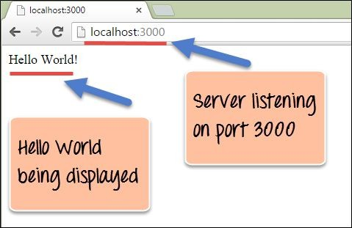
Working with Node.js
‘Hello World’ Application using Express Framework:
Output

Slide 89
Working with Node.js
Request and Response
Express application uses a callback function whose parameters are request and response objects. app.get('/', function (req, res) {
// --
})
Request Object − The request object represents the HTTP request and has properties for the request query string, parameters, body, HTTP headers, and so on.
Response Object − The response object represents the HTTP response that an Express app sends when it gets an HTTP request.
You can print req and res objects which provides a lot of information related to HTTP request and response including cookies, sessions, URL, etc.

Slide 90
Working with Node.js
RESTful API
17

Slide 91
Working with Node.js
What is REST architecture?
Representational State Transfer (REST) is a style of architecture based on a set of principles that describe how networked resources are defined and addressed.
These principles were first described in 2000 by Roy Fielding as part of his doctoral dissertation.
REST is an alternative to SOAP and JavaScript Object Notation (JSON).
A REST Server simply provides access to resources and REST client accesses and modifies the resources using HTTP protocol. Here each resource is identified by URIs/ global IDs. REST uses various representation to represent a resource like text, JSON, XML but JSON is the most popular one.
It is important to note that REST is a style of software architecture as opposed to a set of standards. As a result, such applications or architectures are sometimes referred to as RESTful or REST-style applications or architectures. REST has proved to be a popular choice for implementing Web Services.
An application or architecture considered RESTful or REST-style is characterized by:
State and functionality are divided into distributed resources.
Every resource is uniquely addressable using a uniform and minimal set of commands (typically using HTTP commands of GET, POST, PUT, or DELETE over the Internet).
The protocol is client/server, stateless, layered, and supports caching.

Slide 92
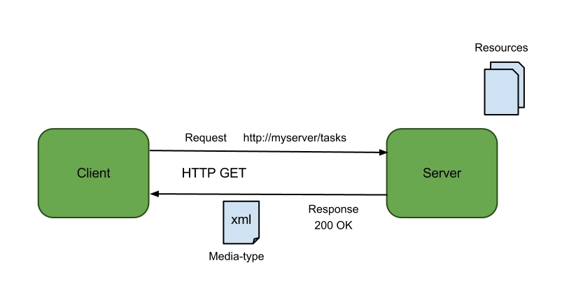
Working with Node.js
RESTful Web Services
A web service is a collection of open protocols and standards used for exchanging data between applications or systems. Software applications written in various programming languages and running on various platforms can use web services to exchange data over computer networks like the internet in a manner similar to inter-process communication on a single computer.
Web services based on REST Architecture are known as RESTful web services. These web services use HTTP methods to implement the concept of REST architecture.
A RESTful web service usually defines an URI, Uniform Resource Identifier a service, which provides resource representation such as JSON and set of HTTP Methods.

Slide 93
Working with Node.js
REST architecture - HTTP methods
Following four HTTP methods are commonly used in REST based architecture.
GET - This is used to provide a read only access to a resource.
PUT - This is used to create a new resource.
DELETE - This is used to remove a resource.
POST - This is used to update an existing resource or create a new resource.caching.

Slide 94
Working with Node.js
Scaling and Packaging
17

Slide 95
Working with Node.js
Node.js - Scaling Application
Node.js runs in a single-thread mode, but it uses an event-driven paradigm to handle concurrency. It also facilitates creation of child processes to leverage parallel processing on multi-core CPU based systems.
Child processes always have three streams child.stdin, child.stdout, and child.stderr which may be shared with the stdio streams of the parent process.
Node provides child_process module which has the following three major ways to create a child process.
exec − child_process.exec method runs a command in a shell/console and buffers the output.
spawn − child_process.spawn launches a new process with a given command.
fork − The child_process.fork method is a special case of the spawn() to create child processes.

Slide 96
Working with Node.js
The exec() method
child_process.exec method runs a command in a shell and buffers the output. It has the following signature
− child_process.exec(command[, options], callback)
Parameters
command (String) The command to run, with space-separated arguments.
options (Object) may comprise one or more of the following options −
cwd (String) Current working directory of the child process
env (Object) Environment key-value pairs
encoding (String) (Default: 'utf8')
shell (String) Shell to execute the command with (Default: '/bin/sh' on UNIX, 'cmd.exe' on Windows, The shell should understand the -c switch on UNIX or /s /c on Windows. On Windows, command line parsing should be compatible with cmd.exe.)

Slide 97
Working with Node.js The exec() method (Continued) Parameters
timeout (Number) (Default: 0)
maxBuffer (Number) (Default: 200*1024)
killSignal (String) (Default: 'SIGTERM')
uid (Number) Sets the user identity of the process.
gid (Number) Sets the group identity of the process.
callback The function gets three arguments error, stdout, and stderr which are called with the output when the process terminates.
The exec() method returns a buffer with a max size and waits for the process to end and tries to return all the buffered data at once.

Slide 98
Working with Node.js
The spawn() method
child_process.spawn method launches a new process with a given command. It has the following signature −
child_process.spawn(command[, args][, options])
Parameters
command (String) The command to run
args (Array) List of string arguments
options (Object) may comprise one or more of the following options −
cwd (String) Current working directory of the child process.
env (Object) Environment key-value pairs.
stdio (Array) String Child's stdio configuration.
customFds (Array) Deprecated File descriptors for the child to use for stdio.
detached (Boolean) The child will be a process group leader.
uid (Number) Sets the user identity of the process.
gid (Number) Sets the group identity of the process.
The spawn() method returns streams (stdout &stderr) and it should be used when the process returns a volume amount of data. spawn() starts receiving the response as soon as the process starts executing.

Slide 99
Working with Node.js
The fork() method
child_process.fork method is a special case of spawn() to create Node processes. It has the following signature −
child_process.fork(modulePath[, args][, options])
Parameters
modulePath (String) The module to run in the child.
args (Array) List of string arguments
options (Object) may comprise one or more of the following options −
cwd (String) Current working directory of the child process.
env (Object) Environment key-value pairs.
execPath (String) Executable used to create the child process.
execArgv (Array) List of string arguments passed to the executable (Default: process.execArgv).
silent (Boolean) If true, stdin, stdout, and stderr of the child will be piped to the parent, otherwise they will be inherited from the parent, see the "pipe" and "inherit" options for spawn()'s stdio for more details (default is false).
uid (Number) Sets the user identity of the process.
gid (Number) Sets the group identity of the process.
The fork method returns an object with a built-in communication channel in addition to having all the methods in a normal ChildProcess instance.
99

Slide 100
Working with Node.js
Node.js - Packaging
JXcore, which is an open source project, introduces a unique feature for packaging and encryption of source files and other assets into JX packages.
Consider you have a large project consisting of many files. JXcore can pack them all into a single file to simplify the distribution.
JXcore Installation
Step 1
Download the JXcore package from http://jxcore.com/downloads/, as per your operating system and machine architecture.
Step 2
Unpack the downloaded file jx_rh64.zip and copy the jx binary into /usr/bin or may be in any other directory based on your system setup.
Step 3
Set your PATH variable appropriately to run jx from anywhere you like.
4. Step 4
You can verify your installation by issuing a simple command as shown below. You should find it working and printing its version number as follows −
> $ jx --version v0.10.32
100

Slide 101
Working with Node.js
Packaging the Code
Consider you have a project with the following directories where you kept all your files including Node.js, main file, index.js, and all the modules installed locally.
JXcore Installation
drwxr-xr-x | 2 | root | root | 4096 | Nov | 13 | 12:42 | images
-rwxr-xr-x | 1 | root | root | 30457 | Mar | 6 | 12:19 | index.htm
-rwxr-xr-x | 1 | root | root | 30452 | Mar | 1 | 12:54 | index.js
drwxr-xr-x | 23 | root | root | 4096 | Jan | 15 | 03:48 | node_modules
drwxr-xr-x | 2 | root | root | 4096 | Mar | 21 | 06:10 | scripts
drwxr-xr-x | 2 | root | root | 4096 | Feb | 15 | 11:56 | style
To package the above project, you simply need to go inside this directory and issue the following jx command. Assuming index.js is the entry file for your Node.js project −
$ jx package index.js index
Here you could have used any other package name instead of index. The above command will pack everything and will create the following two files −
1. index.jxp This is an intermediate file which contains the complete project detail needed to compile the project.
2. index.jx This is the binary file having the complete package that is ready to be shipped to your client or to your production environment.
101

Slide 102
Working with Node.js
Launching JX File
Consider your original Node.js project, running as follows −
$ node index.js command_line_arguments
After compiling your package using JXcore, it can be started as follows −
$ jx index.jx command_line_arguments

Slide 103
Working with Node.js
Case Studies
Below are a few notable examples of enterprises using Node.js for APIs.
1. GoDaddy
In 2015, the website builder team at GoDaddy had already transitioned to a complete Node.js API stack. The tech stack is eclectic because in Charlie Robbins’ words, “the feature is what matters.” GoDaddy offers a wide variety of features from a wide variety of sources. Robbins is the director of UX Platform at GoDaddy, formerly the founder at Nodejitsu and a Gold Director at Node.js Foundation.
In 2015, the website hosting giant found more ways to use Node.js and leverage its benefits. The company moved from a set of monoliths, to micro services and used Node.js to help make that happen.
The company not only focused on leveraging Node.js at every opportunity, but also in replicating the open source culture internally. They found forming working groups and developing mentorships between people on differing teams to be particularly fruitful.

Slide 104
Working with Node.js
2. Netflix
Netflix, the now famous and popular video streaming service, counted 85 million subscribers around the globe in 2016. Serving a changing catalog of movies to an ever-growing subscriber base located anywhere on the planet and using any type of device is no small undertaking. The company evolved their API strategy over time in a continuous effort to improve performance.
In its early days, Netflix was only available on browsers for which they used a Java based web server, which is a monolith. That became too unwieldy for the company to expand beyond browsers to other devices, and to change as needed to do newer things. Because of these limitations with a monolith, the company became one of the earliest adopters of micro services and is credited as one of the most successful users of micro service architecture ever since.
Next in their API evolution, they moved to a REST API, which helped breakup the monolith. That also unlocked the ability to support multiple devices but unfortunately meant weeks of delay between API changes, difficult to maintain due to complexity and inefficient to use. That was followed by API.NEXT that allowed Netflix teams to upload their own custom APIs to the service, all crafted in Ruby. But that led back to a
monolith and higher costs for some instances.
104

Slide 105
Working with Node.js
2. (Continued) Netflix
Today they use a next-generation data access API that is Node.js containers on the front end that connect with an Edge API on the remote service layer that connects to back end services. This is a set of JS data access scripts running Node.js and restify inside of a Docker container. The focus was to provide an infrastructure less environment for UI engineers.
The Node.js runtime is a production-ready platform-as-a-service so the developers need only JavaScript business logic because everything else is already there for them. The company uses SemVer, from the Node.js ecosystem, for versioning management, which they use for packages as well as services. They built an NPM for services index called the Node.js API Index, which tracks all of the versions of published applications and maps back to a Docker image. This helps with the reproducibility of bugs in applications.
SemVer is also used for routing.
105

Slide 106
Working with Node.js
Self Assessment Questions
17

Slide 107
Working with Node.js
Self Assessment Question
Node.js is built on .
Chrome’s V8 Engine
Mozilla’s Spider Monkey
Safari’s Nitro
Edge’s Chakra
Answer: a
107

Slide 108
Working with Node.js
Self Assessment Question
Which one of the given statements is True about Node.js?
Node uses multithread architecture
Node the non-blocking method of I/O
Only i
Only ii
All i and ii
Neither i nor ii
Answer: b
108

Slide 109
Working with Node.js
Self Assessment Question
is a cross platform evented I/O library which comes packaged with Node.
lib
nodelib
libuv
v8lib
Answer: c

Slide 110
Working with Node.js
Self Assessment Question
Rajesh has created a project and packaged it using NPM, he should store the meta data about the project in the file .
metadt.js
package.json
package.js
metadata.json
Answer: b

Slide 111
Working with Node.js
Self Assessment Question
Node.js can process a high number of requests without waiting for any function to return results. This is possible because of .
NPM
Callback functions
Multithreading
Single thread processing
Answer: b

Slide 112
Working with Node.js
Self Assessment Question
When Node JS application starts or ends an operation, class generates events and places them into Event Queue.
Operating System
Server
EventEmitter
Event
Answer: c

Slide 113
Working with Node.js
Self Assessment Question
Which one of the given option describes about Buffers in Node?
Fixed-sized, raw memory allocations outside the V8 heap.
Variable-sized, raw memory allocations outside the V8 heap.
Answer: a

Slide 114
Working with Node.js
Self Assessment Question
Streams are objects that let you read data from a source or write data to a destination in continuous fashion.
Stream is an instance.
Stream class
EventEmitter class
Answer: b

Slide 115
Working with Node.js
Self Assessment Question
Which one of the given statement is a valid statement:
var fs = require("fs")
var fs = require(“node.fs")
Answer: a

Slide 116
Working with Node.js
Self Assessment Question
10. objects do not need a require statement to be included in a node application.
NPM
REPL
Global
fs
Answer: c

Slide 117
Working with Node.js
Self Assessment Question
Given the code:
function printHello() console.log( "Hello, World!");
}
// Now call above function after 2 seconds setTimeout(printHello, 2000);
What does setTImeout() do?
Does a callback of the printHello() function after atleast 2000 ms.
Does a callback of the printHello() function after exactly 2000 ms.
Answer: a

Slide 118
Working with Node.js
Self Assessment Question
The standard, fast and minimalist web framework for node.js is .
Bluebird
Npm
Express.js
Angular.js
Answer: c

Slide 119
Working with Node.js
Self Assessment Question
The code to install express.js is install express.
$ node
$ npm
Answer: b

Slide 120
Working with Node.js
Self Assessment Question
REST stands for .
Representational State Transfer
Repeating State Transfer
Answer: a

Slide 121
Working with Node.js
Self Assessment Question
Which one of the given options is REST-ful architecture?
Has a large set of commands that are needed to identify and address various resources.
Is client/server, stateless, layered, and supports caching.
Answer: b

Slide 122
Working with Node.js
Self Assessment Question
A web service is a collection of open protocols and standards used for exchanging data between applications or systems. State whether True or False.
True
False
Answer: a

Slide 123
Working with Node.js
Self Assessment Question
Concurrency in node is handled using which of the following?
Event driven paradigm
Creating child processes
Multithreading
Both a and b
Answer: d

Slide 124
Working with Node.js
Self Assessment Question
Which one of the given options is the syntax for creating a child process using the exec()?
child_process.exec(command[, callback][, options])
child_process.exec(command[, options], callback)
Answer: b

Slide 125
Working with Node.js
Self Assessment Question
is an open source project, introduces a unique feature for packaging and encryption of source files.
JXPackage
JXcore
Answer: b

Slide 126
Working with Node.js
Self Assessment Question
module is a utility module in node that acts as a network wrapper.
DNS
Wrapper
Net
Domain
Answer: c

Slide 127
Working with Node.js
Self Assessment Question
Which one of the given options is NOT a utility module?
OS module
Domain module
Net module
File module
Answer: d

Slide 128
Working with Node.js
Self Assessment Question
The function is used to run callback repeatedly after at least ms milliseconds.
clearInterval(t).s
setInterval(cb, ms)
setTimeout(cb, ms)
setCallback(cb, ms)
Answer: b

Slide 129
Working with Node.js
Self Assessment Question
Which one of the given options is performed bt the given code? fs.unlink('test.txt', function () { console.log('write operation complete.');
});
Unlinks the file test.txt
Removes the file test.txt from the cache
Deletes the file test.txt
Answer: c
129

Slide 130
Working with Node.js
Self Assessment Question
Which one of the given options is the function of rs+ flag?
Opens file for reading in synchronous mode.
Opens file for reading in asynchronous mode.
Opens file for reading and writing.
Opens file for reading and writing in synchronous mode.
Answer: d

Slide 131
Working with Node.js
Self Assessment Question
25. Chaining is a mechanism to connect the output of one stream to another stream and create a chain of multiple stream operations. The keyword used for performing this operation is called as .
Pipe
Stream
Chain
None of these
Answer: a

Slide 132
Working with Node.js
Assignment
What is the need for Node.js?
Explain the origin and evolution of Node.js.
Explain buffers and streams in node using suitable examples.
Explain event loop and callbacks in node.
Write a node program to open and read a file.
Create a server using node and program it to display a message every time the page is refreshed.
Discuss scaling and packaging in node.
Create a document on how to package a project in NPM.

Slide 133
Working with Node.js
Summary
✔ The JavaScript-based Node.js platform was introduced in 2009, by Ryan Dahl, for Linux and MacOS, as a more scalable alternative to the Apache HTTP Server.
✔ Node.js is defined on the official Node.js website as:
Node.js is a JavaScript runtime built on Chrome’s V8 JavaScript engine. Node.js uses an event-driven, non-blocking I/O model that makes it lightweight and efficient.
✔ All APIs of Node.js library are asynchronous, that is, non-blocking.
✔ REPL stands for Read Eval Print Loop and it represents a computer environment like a Windows console or Unix/Linux shell where a command is entered and the system responds with an output in an interactive mode.
✔ Modules in Node js are a way of encapsulating code in a separate logical unit. There are many readymade modules available in the market which can be used within Node js.
✔ Callback is an asynchronous equivalent for a function. A callback function is called at the completion of a given task. Node makes heavy use of callbacks. All the APIs of Node are written in such a way that they support callbacks.
✔ When Node JS application starts or ends an operation, EventEmitter class generates events and places them into Event Queue.
✔ Express.js is a Node js web application server framework, which is specifically designed for building single-page, multi-page, and hybrid web applications.
133

Slide 134
Working with Node.js
Document Links
Topics
URL
Notes
This link is a tutorial which covers all the basics of node.js
Node.js
https://www.tutorialspoint.com/nodejs/index.htm
Introduction to node.js
https://www.w3schools.com/nodejs/nodejs_intro.asp
This link is a tutorial which covers all the basics of node.js
This link is a tutorial which covers all the basics of node.js
Node.js
https://www.guru99.com/node-js-tutorial.html

Slide 135
Working with Node.js
Video Links
Topics | URL | Notes
NPM | https://www.youtube.com/watch?v=s70-Vsud9Vk | Explains the NPM
Callbacks | https://www.youtube.com/watch?v=ui4-OADfgIk | Explains callbacks in node
Cloud Deployment Models | https://www.youtube.com/watch?v=qV8FgRt-HJI | Explains event loop in node.
File system | https://www.youtube.com/watch?v=XFRQHhKTutI | Explains files in node
Express Framework | https://www.youtube.com/watch?v=45dAt9Gz8rE | Explains Express
Restful API | https://www.youtube.com/watch?v=0oXYLzuucwE | Explains how to create restful API in node

Slide 136
Working with Node.js
E-Book Links
Topics
URL
Page Number
Restful application
Page 76 to 81
Express
http://www.ishtartv.com/articles_files/articles_files120160707040343E1A5.pdf ^{Page 176 - 201}
Node Introduction
Page 3-7

